Slide 1
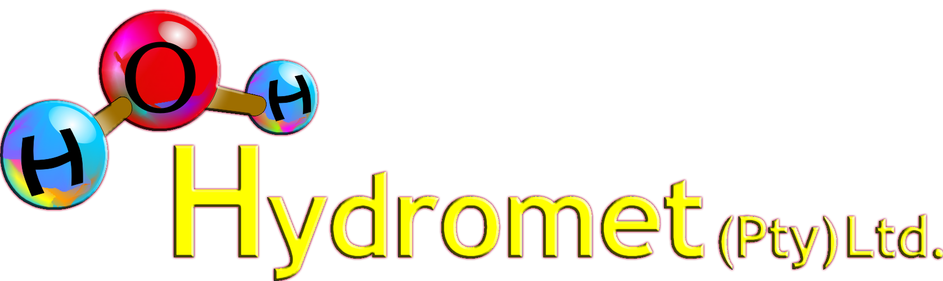
Increasing the Capacity of Existing and New
Exothermic Autoclave Circuits
Grenvil Dunn

Slide 2
Integrated copper pressure plus atmospheric leach
O ₂
QUENCH
FLASH
STEAM
COPPER
CONCENTRATE
REPULP
POX
AUTOCLAVE
FLASH
OXIDE
LEACH
WASH
CCD 1
CCD 7
TAILINGS
SX
Cu Ew
COPPER
PRODUCT

Slide 3
Heat removal systems
Internal cooling coils
OXYGEN
FEED
DISCHARGE
TO FLASH
AUTOCLAVE
COOLING
FLUID

Slide 4
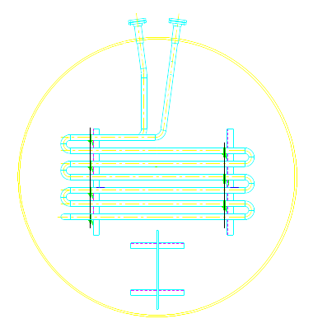
Heat removal systems
Internal cooling coils

Slide 5

Heat removal systems
External cooling
FEED
OXYGEN
CWS
CWS
DISCHARGE
TO FLASH

Slide 6
Heat removal systems
Quench cooling
OXYGEN
DISCHARGE
TO FLASH
FEED
AUTOCLAVE
COOLING
FLUID

Slide 7
Heat removal systems
Flash cooling and recycle
FLASH
VAPOUR
FLASH
TANK
OXYGEN
DISCHARGE
TO FLASH
CONC
SLURRY
CONC
TANK
FEED
TANK
AUTOCLAVE

Slide 8
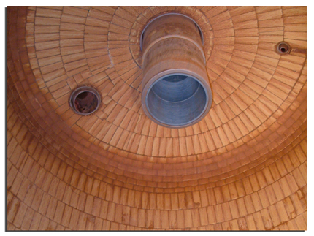
Heat removal systems
Flash cooling and recycle
Advantages:
  Retention time
  Optimal use of active volume
  Process liquor concentration
  Smoothing to density excursions
Disadvantage:
Additional let down circuit

Slide 9
Capacity increase in exothermic autoclave circuit
Flash cooling and recycle
Incorporating a Thickener

Slide 10
Flash-Thickener-Recycle (F T R) Circuit
FLASH
FLASH
TANK
QUENCH
CONC
SLURRY
DISCHARGE
TO FLASH
FLASH
U/FLOW
TANK
FEED
TANK
AUTOCLAVE
LEACH
PRODUCT
FLASH
THICKENER

Slide 11
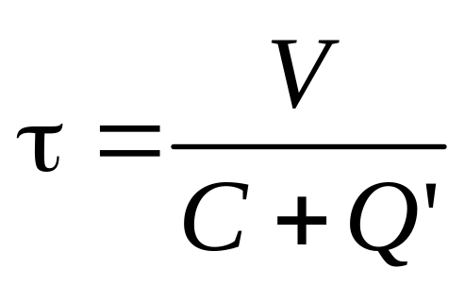


Retention time: Quench Cooling
CONCENTRATE
SLURRY
DISCHARGE
Active volume = V
QUENCH

Slide 12
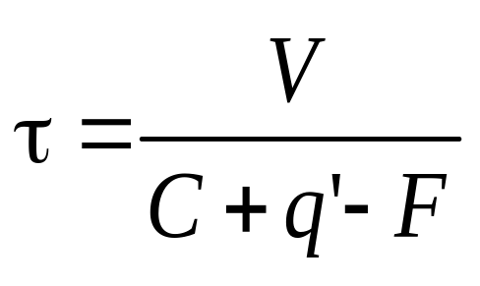
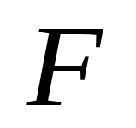

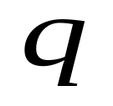
Retention time: Flash-Recycle
FLASH
FLASH
TANK
CONC
SLURRY
DISCHARGE
Active volume = V
QUENCH

Slide 13
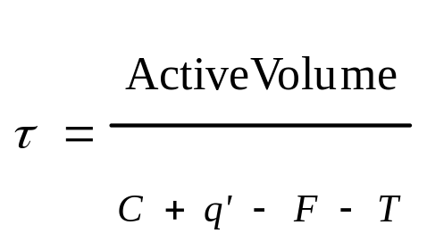
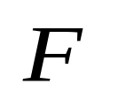



Retention time: Flash-Thickener-Recycle
FLASH
FLASH
TANK
QUENCH
DISCHARGE
FEED
FLASH
U/FLOW
TANK
FEED
TANK
Active volume = V
THICKENER
OVERFLOW
THICKENER

Slide 14
Design considerations with F T R
Requires an exothermic system

Slide 15
Design considerations with F T R
Requires an exothermic system
Feed mass reduction across leach

Slide 16
Design considerations with F T R
Requires an exothermic system
Feed mass reduction across leach
Configure for high reaction extent in first compartment

Slide 17
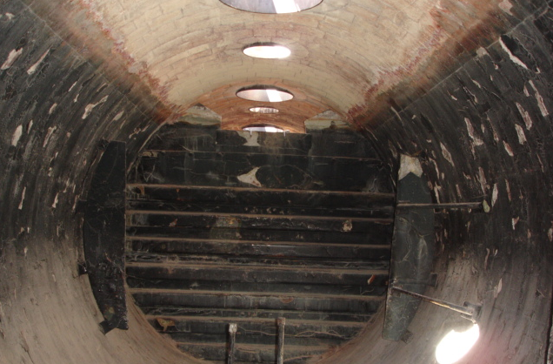

Slide 18
Design considerations with F T R
Requires an exothermic system
Feed mass reduction across leach
Configure for high reaction extent in first compartment
High oxygen mass transfer in first compartment

Slide 19
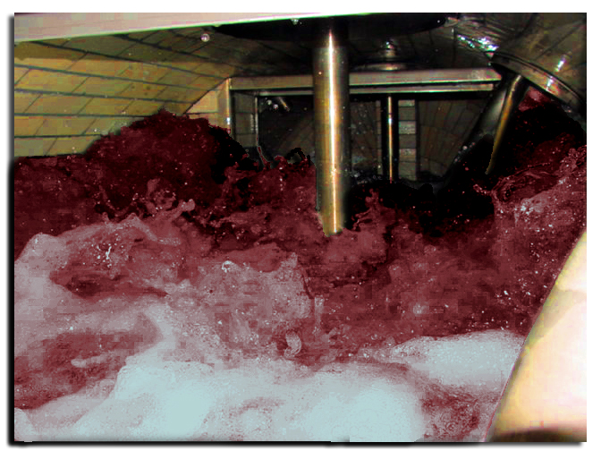
Higher oxygen transfer rates

Slide 20
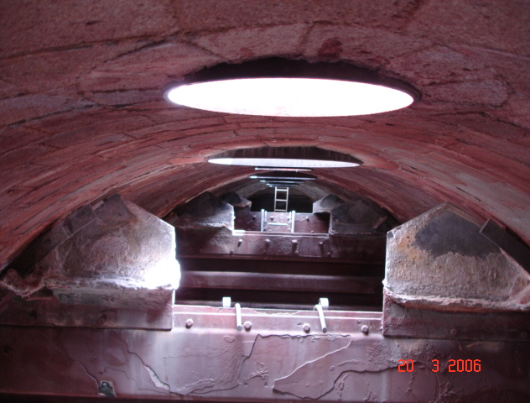
Dividing wall detail

Slide 21
F T R installations
Covellite-Chalcocite POX leach

Slide 22
Covellite-Chalcocite POX leach
FLASH
VAPOUR
OXYGEN
FLASH
SULPHURIC
ACID
SULPHIDE
FEED
THICKENER
SURGE
TANK
FEED
TANK
AUTOCLAVE
FTR
THICKENER

Slide 23
F T R installations
Covellite-Chalcocite POX leach
Kansanshi Mining

Slide 24
Kansanshi Mining’s Chalcopyrite
POX circuit with quench cooling
OXYGEN
VENT
DISCHARGE
TO FLASH
CONCENTRATE
FEED
TANK
AUTOCLAVE
SULPHURIC
ACID
RAFFINATE
QUENCH

Slide 25
Kansanshi Mining’s Chalcopyrite
POX circuit with F T R
FLASH TO
HEAT
RECOVERY
FLASH
TANK
RAFFINATE
FLOCCULATOR
FTR
THICKENER
PRODUCT
TO ATMOS
LEACH
OXYGEN
DISCHARGE
TO FLASH
CONCENTRATE
FEED
TANK
AUTOCLAVE
RAFFINATE
DILUTION
QUENCH

Slide 26
Kansanshi – Specific process factors
Quench Concept
FTR
Concept
Specific autoclave feed rate | (t.concentrate/day m³) | 1.14 | 3.04
Sulphuric acid requirements | (t/tonne concentrate) | 0.43 | ~nil
Mean solids retention time | (h) | 0.94 | 0.94
Slurry feed rate | (m³/h) | 7.2 | 78
Dilution feed rate | (m³/h) | 65 | 110-140
Oxygen transfer rate | (kg/m³h) | 62 | 147

Slide 27
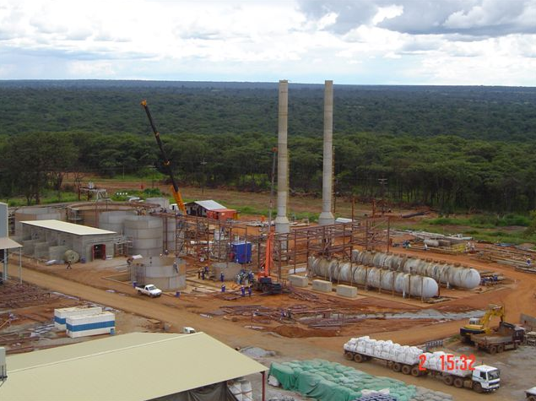
Aerial view of the Kansanshi POX plant in construction

Slide 28
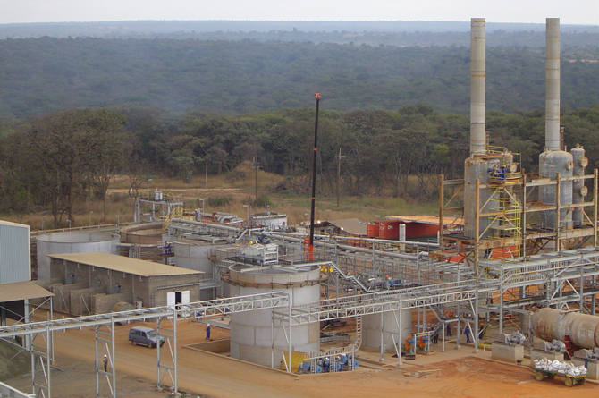
Location for F T R thickener

Slide 29
Other opportunities
Nickel sulphides

Slide 30
Leaching of nickel sulphides
FLASH
FLASH
TANK
OXYGEN
SULPHIDE
FEED
DISCHARGE
TO FLASH
FLASH
U/FLOW
TANK
FEED
TANK
AUTOCLAVE
PREGNANT
LEACH
SOLUTION
FTR
THICKENER

Slide 31
Other opportunities
Nickel sulphides
Kinetically different systems

Slide 32
Kinetically different leach systems
FLASH
PGE
LIXIVIANT
OXYGEN
FLASH
TANK
FLASH
FLASH
TANK
PGM
RECOVERY
FOLLOWED
BY BASE
METAL
RECOVERY
FLASH
U/FLOW
TANK
FEED
TANK
AUTOCLAVE
DISCHARGE
TANK
FEED
CONC
BASE
METAL
LEACHATE
FTR
THICKENER
FEED
TANK

Slide 33
Flash-Thickener-Recycle
Applicable to new and existing circuits

Slide 34
Flash-Thickener-Recycle
Applicable to new and existing circuits
Exothermic POX circuits

Slide 35
Flash-Thickener-Recycle
Applicable to new and existing circuits
Exothermic POX circuits
Significant capacity upgrades

Slide 36
Flash-Thickener-Recycle
Applicable to new and existing circuits
Exothermic POX circuits
Significant capacity upgrades
Process liquor concentration

Slide 37
Flash-Thickener-Recycle
Applicable to new and existing circuits
Exothermic POX circuits
Significant capacity upgrades
Process liquor concentration
Reduced volumetric flow to SX

Slide 38
Flash-Thickener-Recycle
Applicable to new and existing circuits
Exothermic POX circuits
Significant capacity upgrades
Process liquor concentration
Reduced volumetric flow to SX
Smoothes feed density fluctuations

Slide 39
Thank you!

